Slide 1


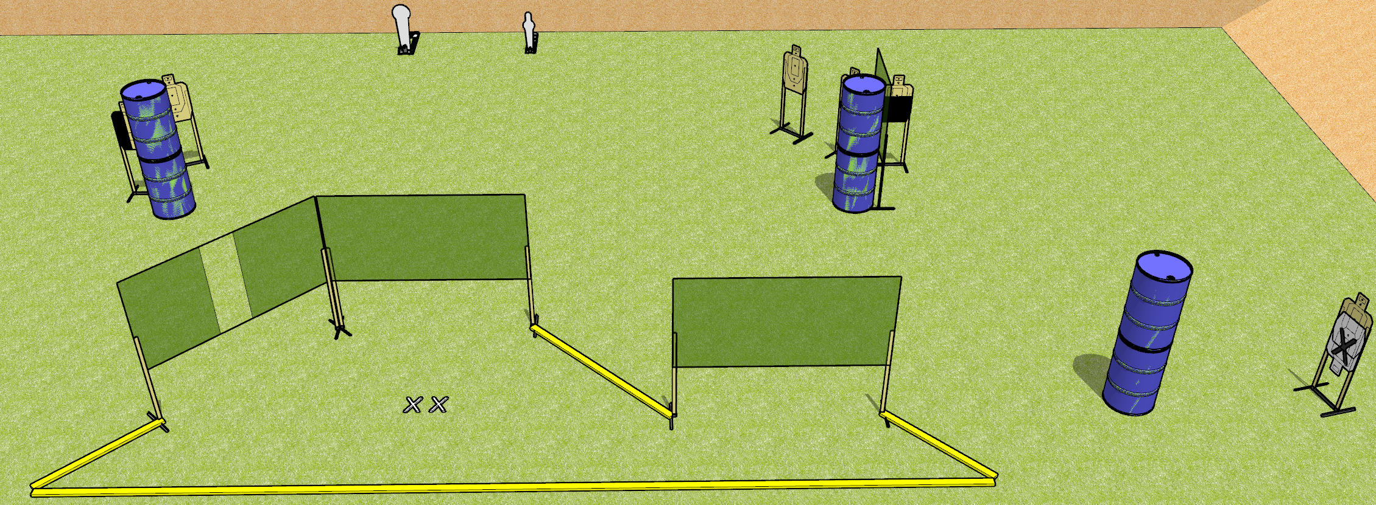
 | Dothan Gun Club – USPSA Match Three Times Course Designer : Drew Coleman
START POSITION : Standing with both feet on X’s, wrists below belt
GUN READY CONDITION : Pistol loaded and holstered. PCC loaded, held with both hands, buttstock on belt, safety on. |  | SCORING: Comstock, 20 rounds TARGETS: 6 paper, 2 Steel SCORED HITS: Best 3 on paper, steel until down START-STOP: Audible, last shot RULES:
STAGE PROCEDURE: Engage targets as they become available from within the fault lines.

Slide 2
Three Times
Written Stage Briefing
Three Times is a 20 round, 100 point, Comstock medium course. There are six USPSA targets, one Colt popper, and one mini popper. The best three hits on paper will score, and steel must fall to score. The start signal is audible.
Handgun start position is standing with both feet on X’s, wrists below belt. Handgun is loaded and holstered.
PCC start position is standing with both feet on X’s. Loaded carbine is held with both hands, buttstock on belt, safety on.
On start signal, engage targets as they become available from within the shooting area.

